Slide 1
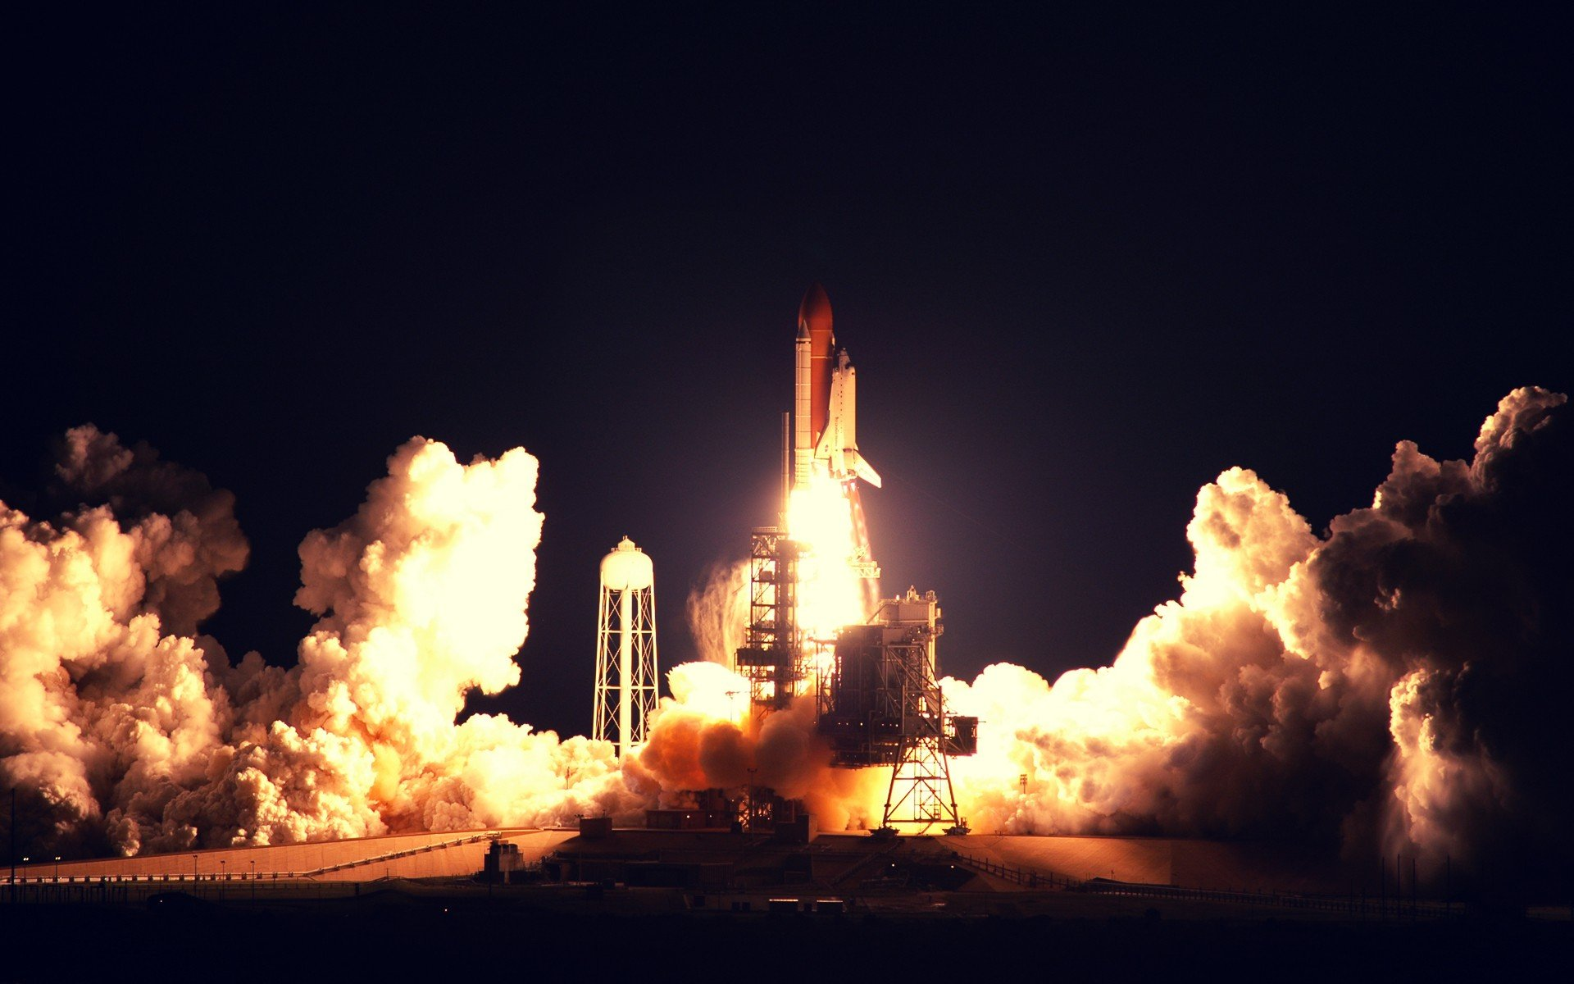

Winning Space Race
With Data Science
Alberto Arancet
25-07-2025

Slide 2

Outline
Executive Summary
Introduction
Methodology
Results
Conclusion
Appendix

Slide 3
Executive Summary
SpaceX have being at the frontier in the space business thanks to the revolutionizing methodology of reusable rockets ( in this case boosters and launchers).
The recovery of their rockets had made them a very profitable since their reduce their cost in a big way, of course the recovery of each rocket depend on different factors, in this report we can get a prediction of the model of a 94,4%, depending of course of the payload, and orbit

Slide 4
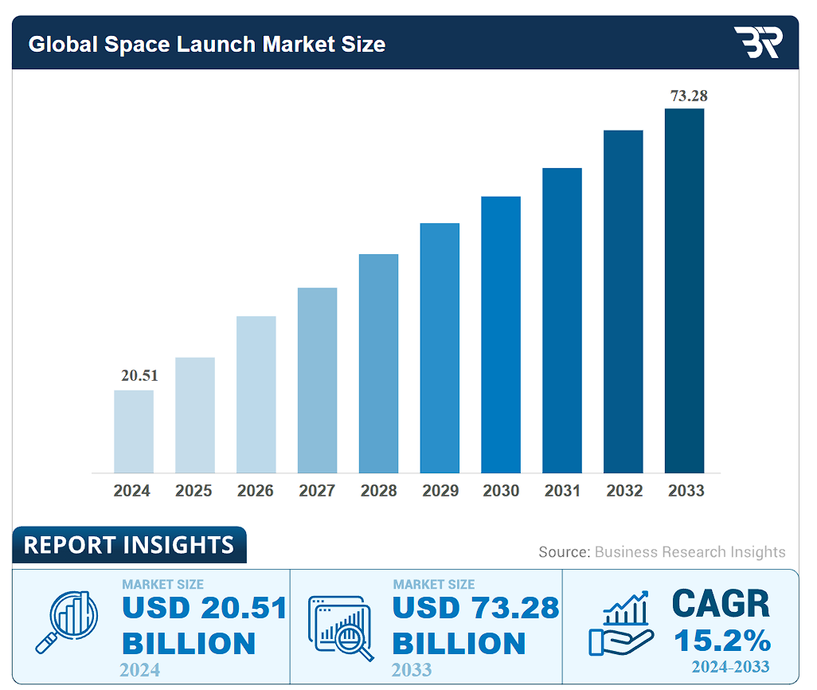
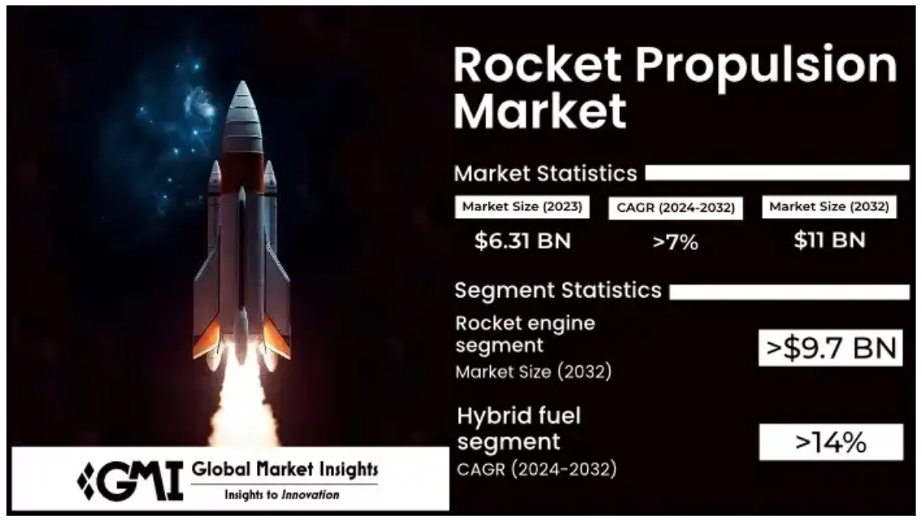
Introduction – Project Background and context
Space, specially the business related has being growing, the global space launch market as being on the rise in a very fast pace, this growth is being lead by the increase interest of the private sector in the areas of satellite launchers, space exploration and advance in technologies like propulsion
Space Launch Market Size, Growth | Report [2025-2033]
Rocket Propulsion Market Size, Share & Forecast Report - 2032

Slide 5
Introduction – Problem we want to tag
SpaceX had being very successful in the business of space, specially in frontier of the idea of recovery or reusable rockets. Falcon 9 rocket launches with a cost of 62 million dollars when the first stage of their rockets can be reused.
The success recovery of the booster is one of the key factor for the profitability of SpaceX, this is the most important cost reduction in their line.
This report is being made with the mission of predict the success or like hood of the first stage rocket landing for use recovery.

Slide 6

Section 1
Methodology

Slide 7
Methodology
Executive Summary
Data collection methodology:
Perform data wrangling
Perform exploratory data analysis (EDA) using visualization and SQL
Perform interactive visual analytics using Folium and Plotly Dash
Perform predictive analysis using classification models

Slide 8
Data Collection
Describe how data sets were collected.
The data was collected from different sources, in this case open source Space X Rest API, Web Scraping Falcon9 launch data from Wikipedia

Slide 9
Data Collection – SpaceX API
Import libraries and define auxiliary functions
Request the data from SPaceX api
Request and parse the SpaceX launch data using the GET request
Filter the dataframe to only include Falcon 9 launches
Use Data Wrangling to deal with Missing Values
Export to a CSV
capstone/jupyter-labs-spacex-data-collection-api.ipynb at main · AlbertoArancetMerino/capstone

Slide 10
Data Collection - Scraping
Extract a Falcon 9 launch records HTML table from Wikipedia and parse the table and convert it into a Pandas data frame
Request the Falcon9 Launch Wiki page from its URL
Extract all column/variable names from the HTML table header
Create a data frame by parsing the launch HTML tables
Export to a CSV
capstone/jupyter-labs-webscraping.ipynb at main · AlbertoArancetMerino/capstone

Slide 11
Data Wrangling
Explored data to determine the label for training supervised models
Calculated the number of launches on each site
Calculated the number and occurrence of each orbit
Training label: 'Class’
Calculated the number and occurrence of mission outcome per orbit type
Created a landing outcome training label from 'Outcome' column
capstone/labs-jupyter-spacex-Data wrangling.ipynb at main · AlbertoArancetMerino/capstone

Slide 12
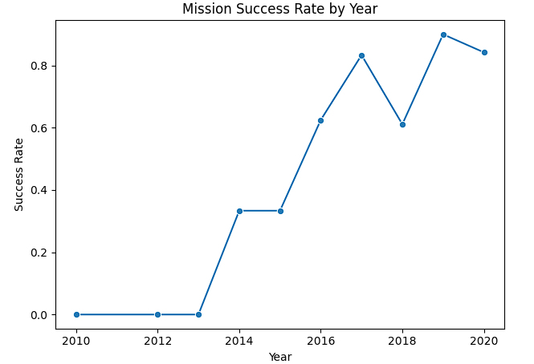
EDA with Data Visualization
Loaded data into an IBM DB2 Instance
Run diferente SQL queries to extract information about:
Diferent Launch sites
Payload masses
Mission outcomes
Booster landings
capstone/edadataviz.ipynb at main · AlbertoArancetMerino/capstone

Slide 13
EDA with SQL
We run SQL queries to get and list the different information about
Launch sites
Payload masses
Booster versions
Mission outcomes
Failure outcomes
Booster landins
Landings outcoms
capstone/jupyter-labs-eda-sql-coursera_sqllite.ipynb at main · AlbertoArancetMerino/capstone

Slide 14
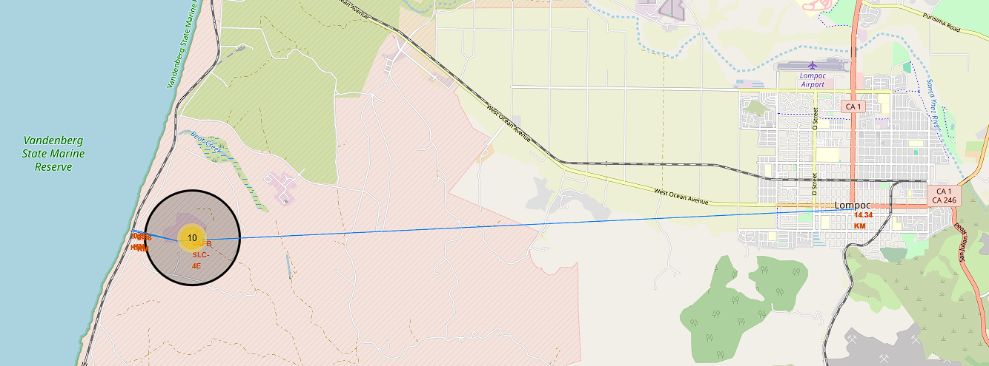
Build an Interactive Map with Folium
Data Visualization:
Launch Sites Location Analysis
Used Python interactive mapping library called Folium
Marked all launch sites on a map
Marked the successful/failed launches for each site on map
Mark Railways / Highways / Coastlines close to the launch site
Calculated the distances between a launch site to its proximities Cities
Screenshot of interactive Folium map showing proximity from VAFB-SLC 4E launch site to nearby railway, highway, and coastline
capstone/lab_jupyter_launch_site_location.ipynb at main · AlbertoArancetMerino/capstone

Slide 15
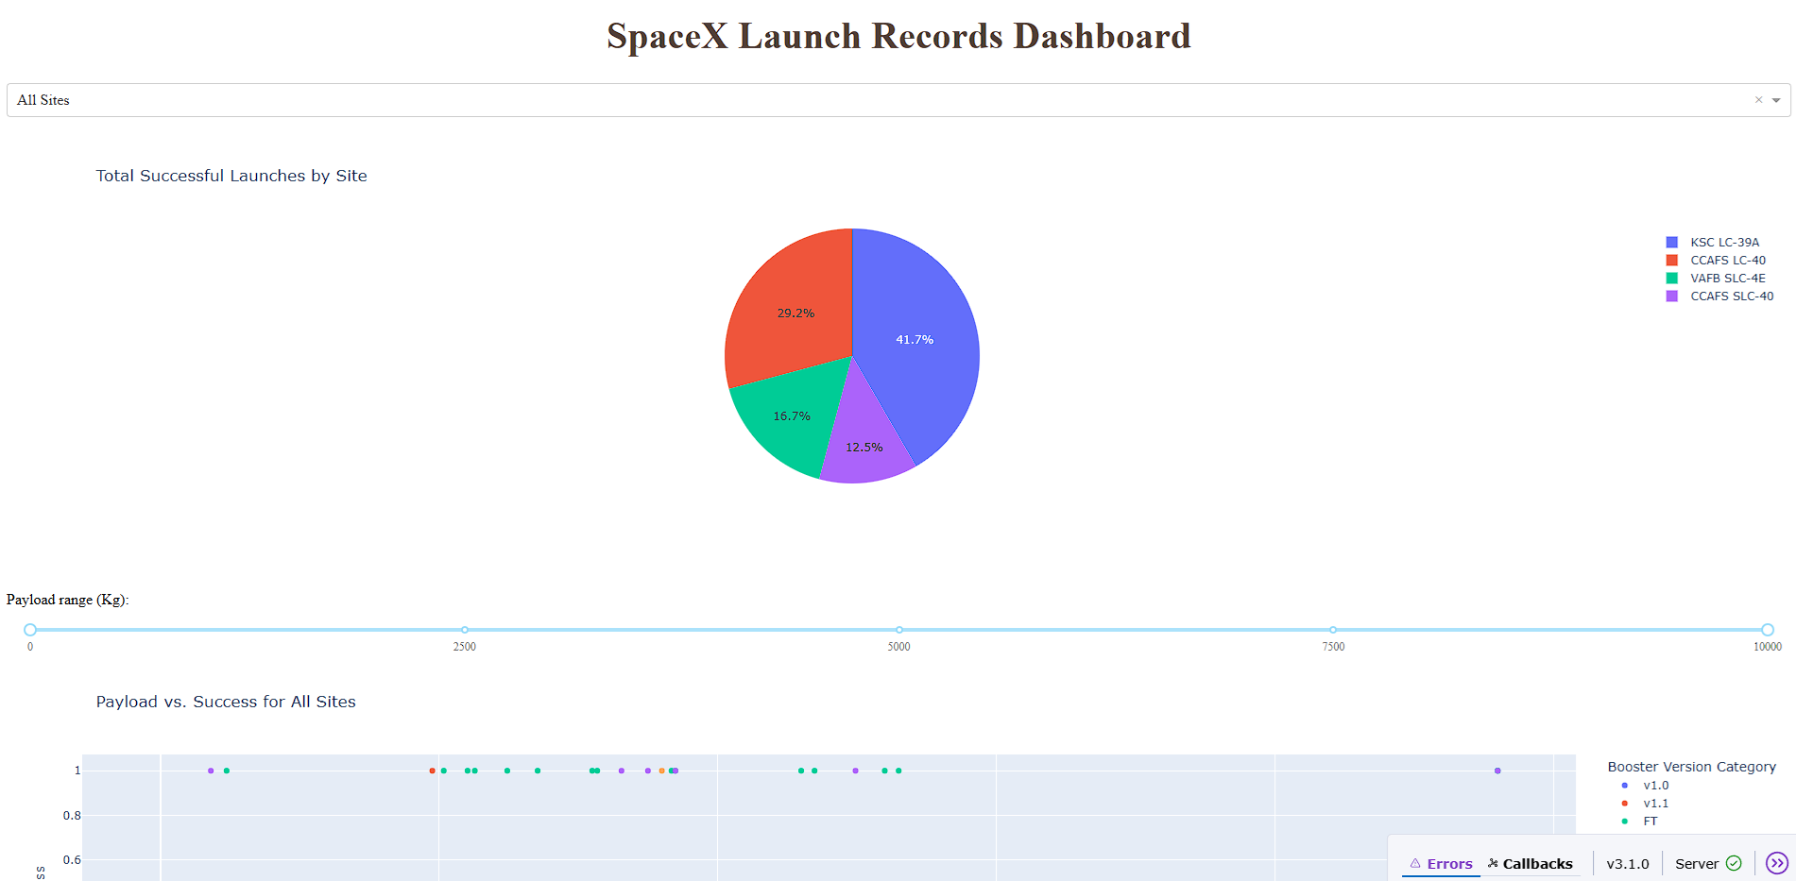
Build a Dashboard with Plotly Dash
The dashboard was made with Plotly this include a :
Dropdown menu for selecting launch sites Pie charts displaying success rate.
Scatter chart displaying launch site, payload mass, success/failure Range with a slider for selecting range of payload mass (kg)
capstone/spacex-dash-app.py at main · AlbertoArancetMerino/capstone

Slide 16
Predictive Analysis (Classification)
Import libraries and difine functions to create confusion matrix
Loaded the daraframe created during data collection
Create a columna for out training label Class during data wrangling
Standardized the data
Split the data into training data and test data
Fit the trining data to various models types
Use a cross-validation grid-search over a variety of parameters to select the best ones for each model
Evualuate accuracy of each model
capstone/SpaceX_Machine Learning Prediction_Part_5.ipynb at main · AlbertoArancetMerino/capstone

Slide 17
Results
Exploratory data analysis results
Interactive analytics demo in screenshots
Predictive analysis results

Slide 18
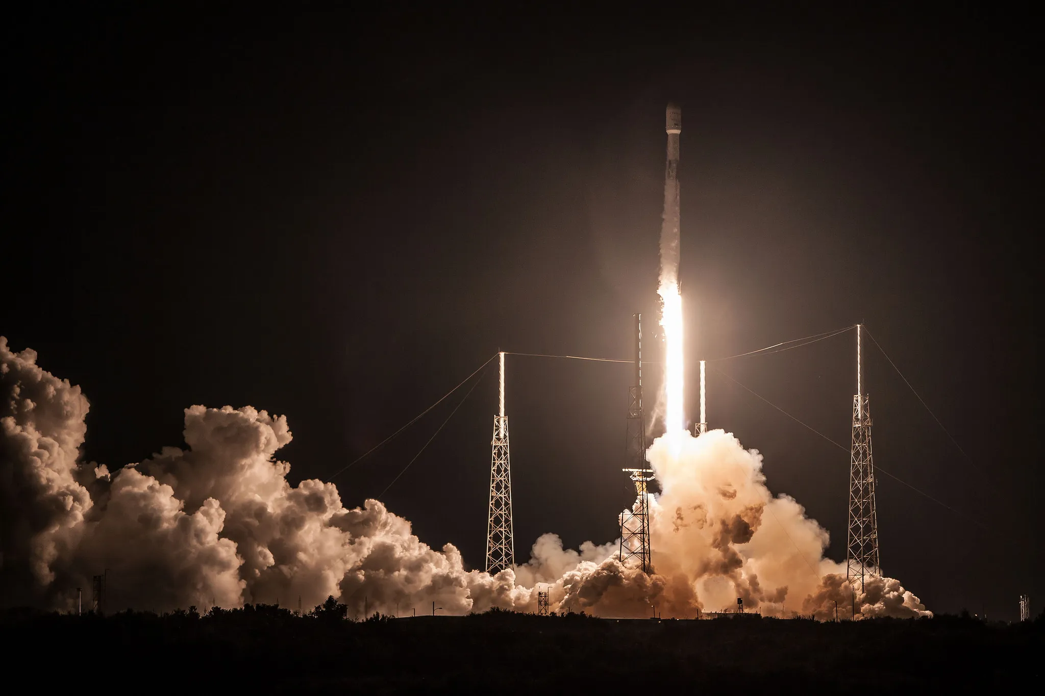
Section 2
Insight drawn
From EDA

Slide 19
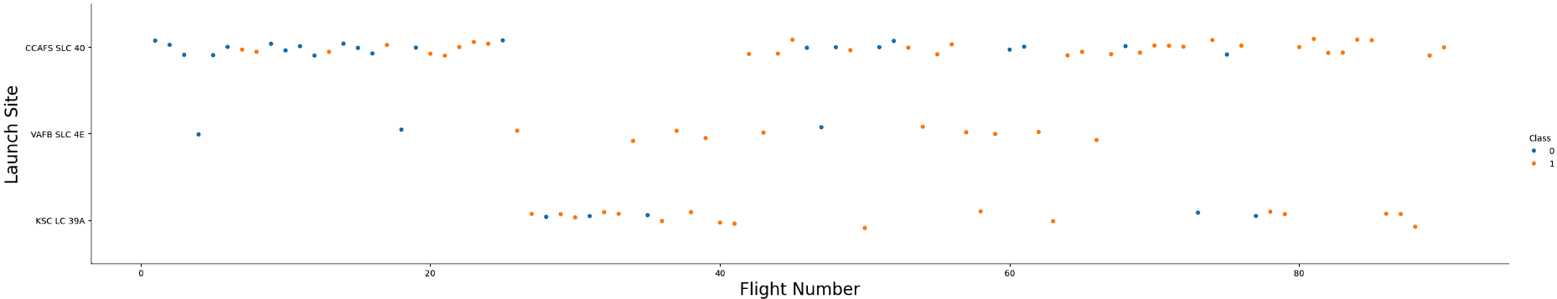
Flight Number vs. Launch Site
Show a scatter plot of Flight Number vs. Launch Site
This chart shows the values of Launch Sites, Flight Numbers and the success/failure of each launch
For what we can gather:
CCAFS-SLC have the highest launch and also is the site with the more failures

Slide 20
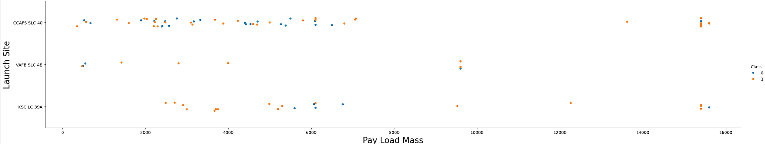
Payload vs. Launch Site
Show a scatter plot of Payload vs. Launch Site
This chart shows the payload mass per launch site and the success/failure of each launch
For what we can gather:
The heavy payload have less chance of failure

Slide 21
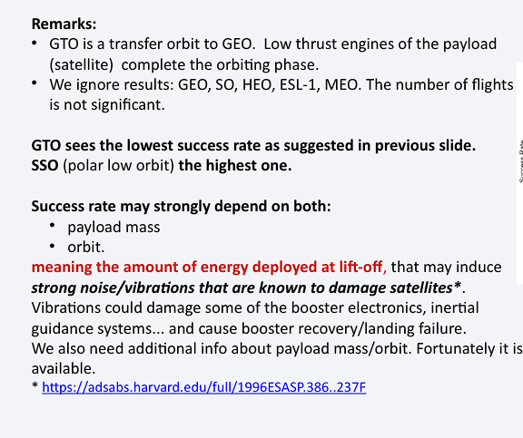
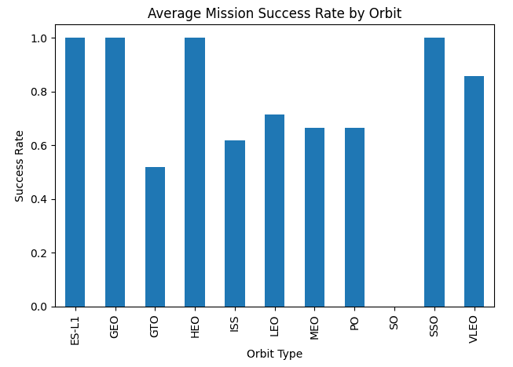
Success Rate vs. Orbit Type
Show a bar chart for the success rate of each orbit type
Show the screenshot of the scatter plot with explanations

Slide 22
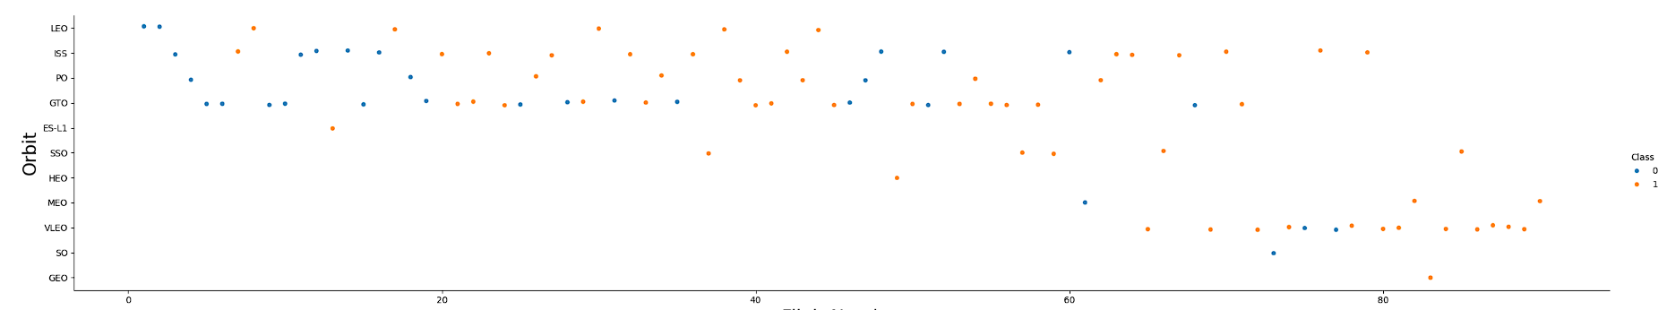
Flight Number vs. Orbit Type
Flight Number vs. Orbit Type
This chart info is about orbit vs flight number, it shows the success rate vs flight, orbit.
For what we can gather:
Lower orbits are a lower risk

Slide 23
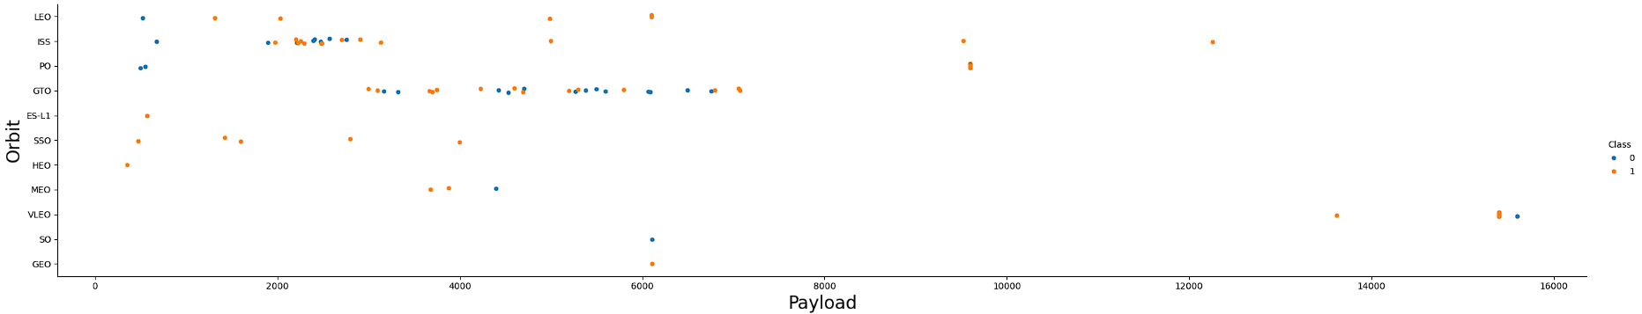
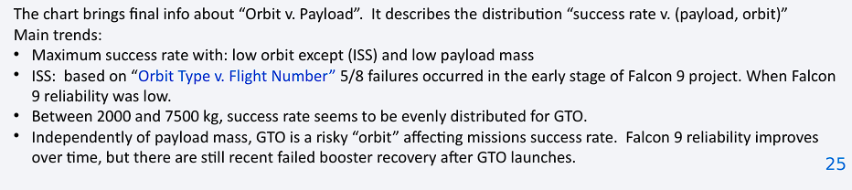
Payload vs. Orbit Type
Payload vs. Orbit Type
This chart info is about orbit vs playload, it shows the success rate vs payload, orbit.
For what we can gather:
Independently of the diferente payload mass, GTO is a very risky orbit affecting the diferente missions success rate, even when the falcon 9 reliability improves there still failed booster recovery

Slide 24
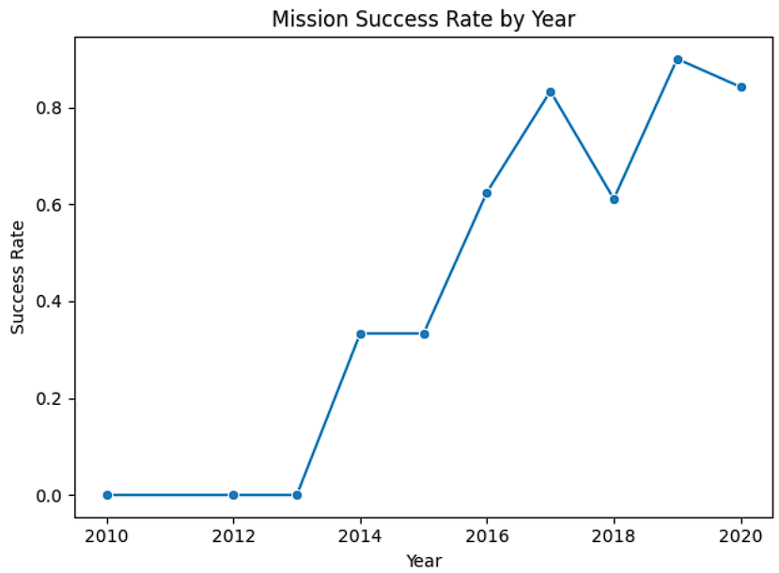
Launch Success Yearly Trend
Launch Succsess Yearly trend
In this chart we can se how the Falcon 9 reliability increase or improves over time.
For what we can gather:
Success rate and recovery depend on the payload mass and orbit
The falcon 9 average recovery rate is of 66%

Slide 25
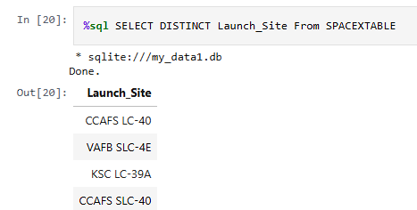
All Launch Site Names
CCAFS LC-40
VAFB SLC-4E
KSC LC-39A
CCAFS SLC-40
Query result

Slide 26
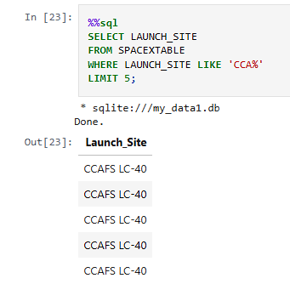
Launch Site Names Begin with 'CCA'
Launches with CCA

Slide 27
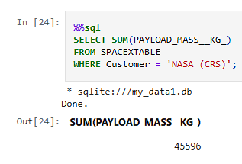
Total Payload Mass
We use a SQL quary to to calculate the total payload mass in KG, of all the records in the table SPACEX where the Customer is “NASA (NRS)”
“Select Sum(PAYLOAD_MASS__KG_)” is the total sum of the payload carried by the rocket
“FROM SPAXTABLE” this speciefies the table where the data is stored
“WHERE Customer = ‘NASA (NRS)´” is the aplied filter so it can only sum a specific set in the case the NASA (NRS)

Slide 28
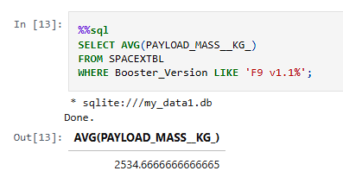
Average Payload Mass by F9 v1.1
We use a SQL quary to to calculate the avarage payload mass in KG from the table, where only include records of the Boster version F9 V1.1
From this we can see that the payload mass is 2534,7 Kg

Slide 29
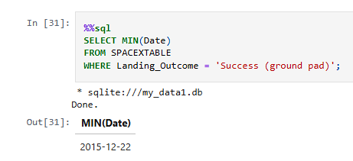
First Successful Ground Landing Date
We use a SQL query to find the first or realiest launch date from the SPACEX table where the rocket had a successful landing on a graund pad
“SELECT MIN(Date)” take the minimum or earliest value from the date comun
“FROM SPACEXTABLE” use the data from the SPACEX Table
“WHERE Landing_Outcome = 'Success (ground pad)’” this is the filter , for those records where the landing was successful and hapend on a ground pad

Slide 30
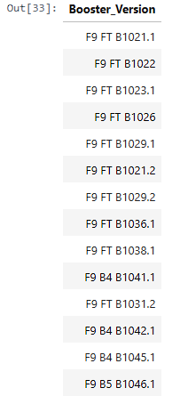
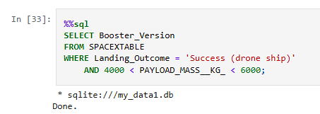
Successful Drone Ship Landing with Payload between 4000 and 6000
We use a SQL query to find the booster Version for a launcher that landed successfully in a drone ship and carried a payload masss between 4000 kg and 6000 kg
“SELECT Booster_Version FROM SPACEXTABLE” List the booster types from the table SPACEX
“WHERE Landing_Outcome = 'Success (drone ship)’” filter the success landing on adrone ship
“AND 4000 < PAYLOAD_MASS__KG_ < 6000” make another filter por the payload range

Slide 31
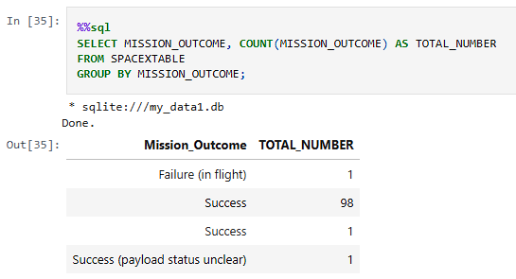
Total Number of Successful and Failure Mission Outcomes
Calculate the total number of successful and failure mission outcomes
Present your query result with a short explanation here
We use a SQL query to find and count the total number of successful and failure misión outcomes
“SELECT MISSION_OUTCOME” this retrieves the mission result
“COUNT(MISSION_OUTCOME) AS TOTAL_NUMBER” this caunt how many times the outcome hapend"
“FROM SPACEXTABLE GROUP” this take the data from the SPACEX table
“BY MISSION_OUTCOME” this group the different records by outcome type

Slide 32
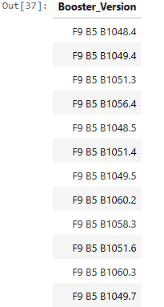
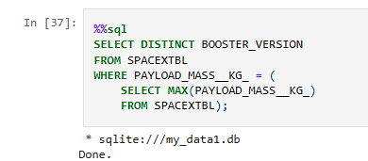
Boosters Carried Maximum Payload
We use a SQL query to find the diferent/unique booster that carried the maximum payload
“SELECT DISTINCT BOOSTER_VERSION FROM SPACEXTBL ” this give us the unique or distinct booster types from the SPACEX table
“WHERE PAYLOAD_MASS__KG_ =“ this filter the payload mass equals the maximum mass found in the table
( SELECT MAX(PAYLOAD_MASS__KG_) FROM SPACEXTBL)” an then this select the maximum payload

Slide 33
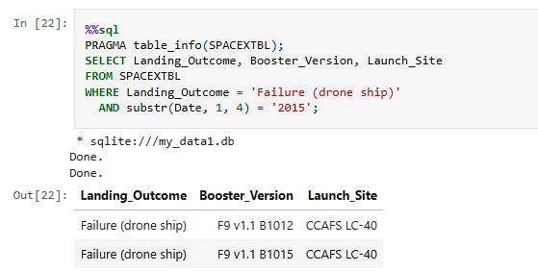
2015 Launch Records
We use a SQL query to launch fails in the year 2015
PRAGMA table_info(SPACEXTBL); this give us list of column details from the
SELECT Landing_Outcome, Booster_Version, Launch_Site FROM SPACEXTBL this give us how it landed (Landing_Outcome), the rocket version (Booster_Version), and where it launched (Launch_Site)
WHERE Landing_Outcome = 'Failure (drone ship)’ this Filters only those missions that had a failed landing on a drone ship
AND substr(Date, 1, 4) = '2015’; This take data for launches in 2015

Slide 34
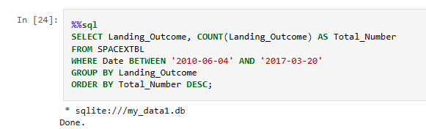
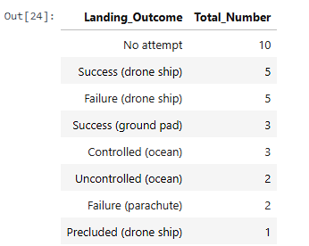
Rank Landing Outcomes Between 2010-06-04 and 2017-03-20
We use a SQL query to count the total landin outcomes
“SELECT Landing_Outcome COUNT(Landing_Outcome) AS Total_Number FROM SPACEXTBL” this take each landing result and times it occurred.
“WHERE Date BETWEEN '2010-06-04' AND '2017-03-20’” this Filters missions only within that time window.
GROUP BY Landing_Outcome ORDER BY Total_Number DESC; Groups by each distinct landing result and sort it

Slide 35
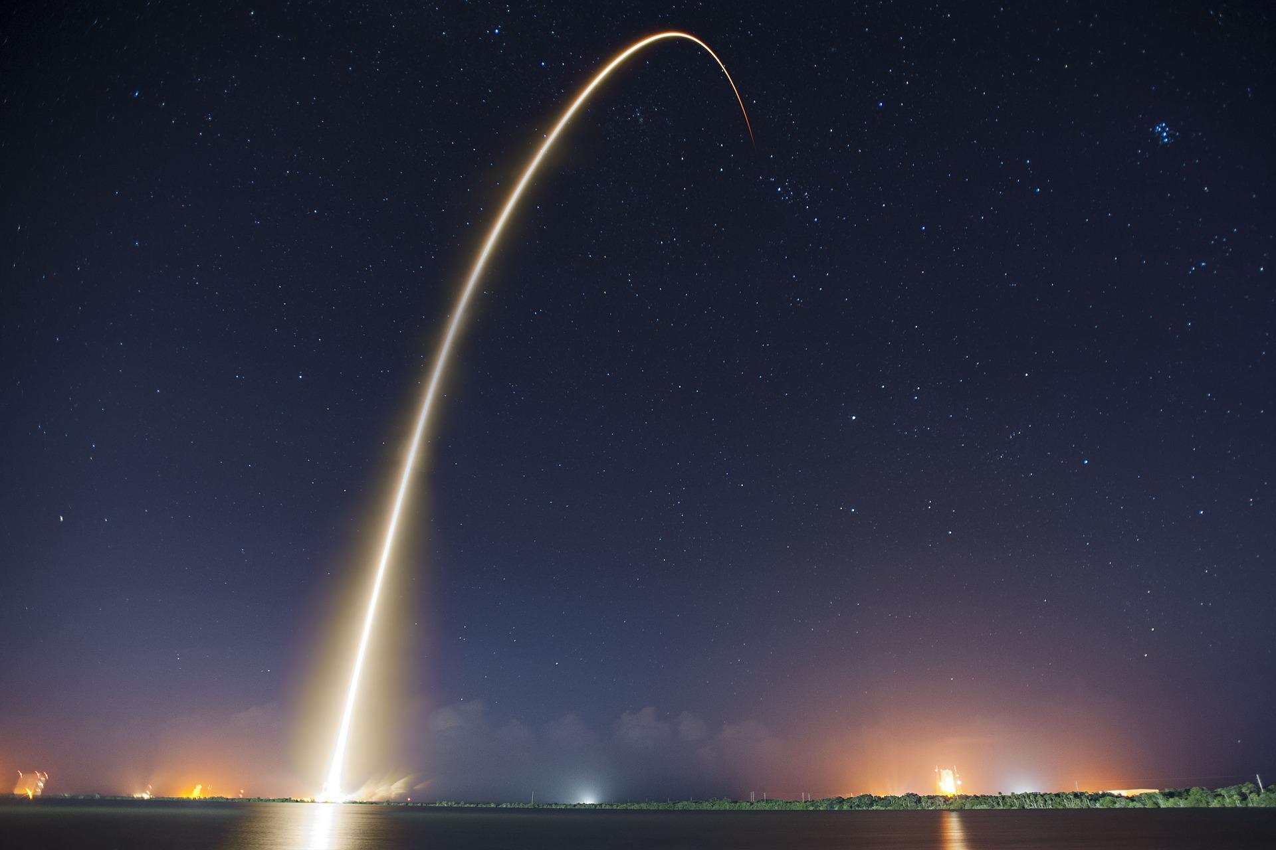
Section 3
Launch Site
Proximities Analysis

Slide 36
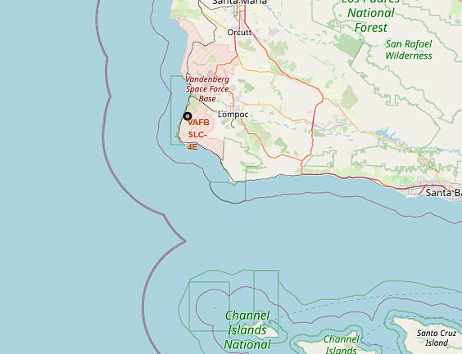
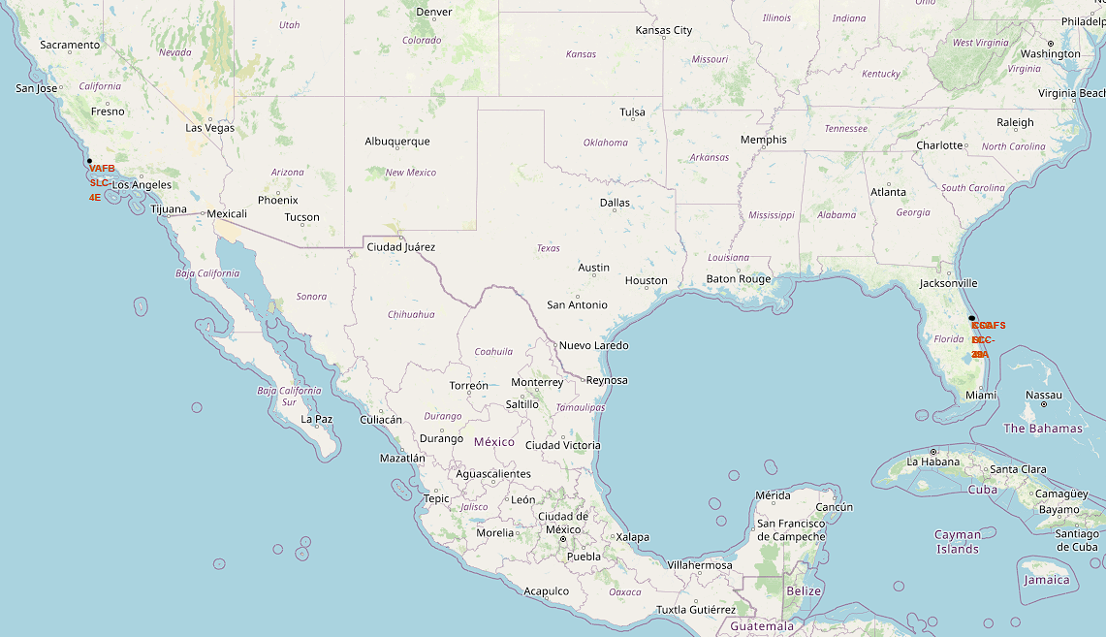
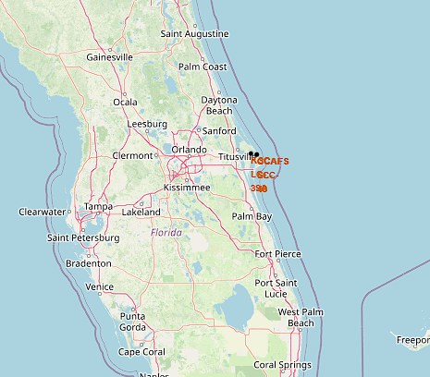
Launch location analysis
Launch sites locations
VAFB SLC-4E, KSC-LC29A, CCAFS-LC4O,CCAF-SLC40

Slide 37
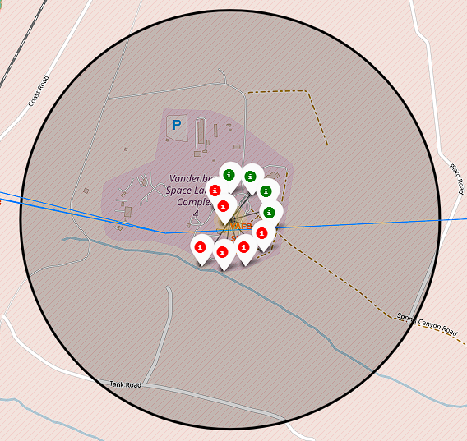
VAFB-SLC 4E launch site
Visualizing the booster landing outcomes for each launch site highlights which launch sites have relatively high success rate this case the selected launch site , being VAFB-SLC 4E, have a very low success rate

Slide 38
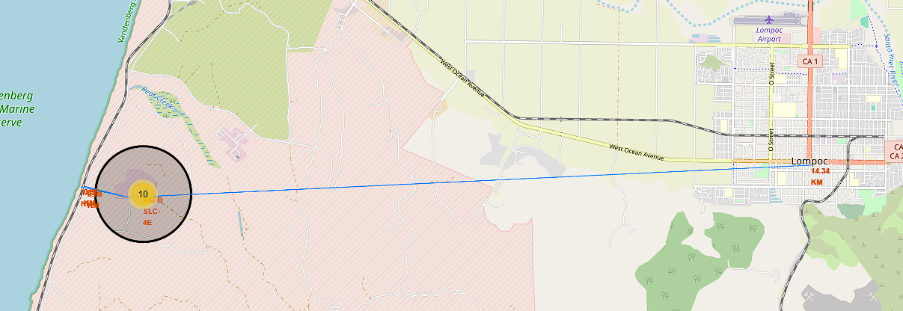
Distance and landmarks
Distance city = 14.339346934328596 km
Distance railroad = 0.976072106423253 km
Distance highway = 0.8771731735070982 km

Slide 39
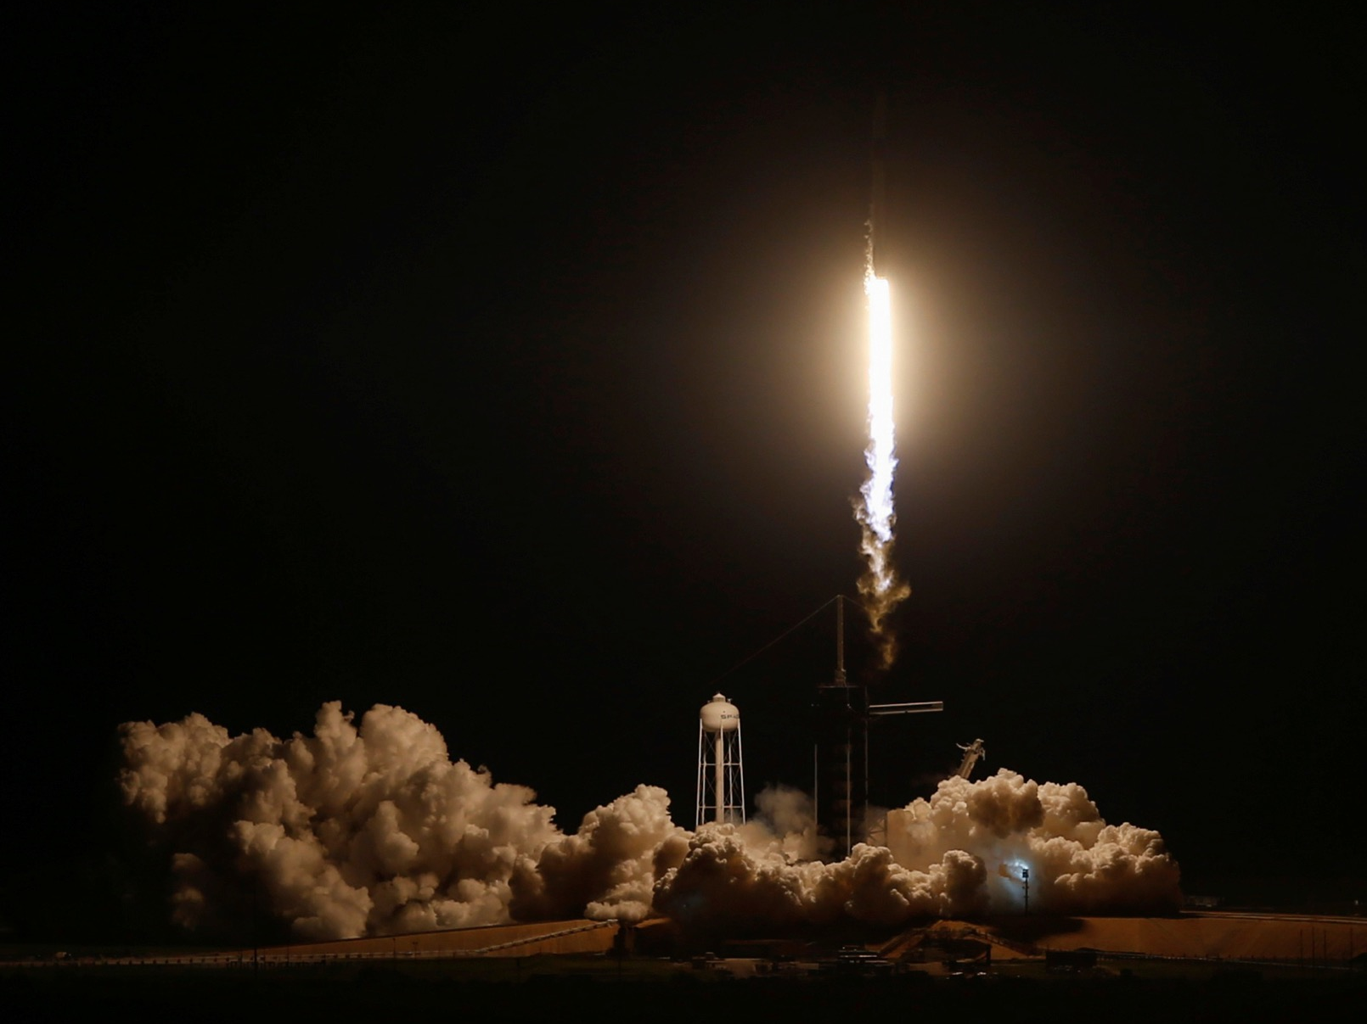
Section 4
Build a Dashboard
With Plotly Dash

Slide 40
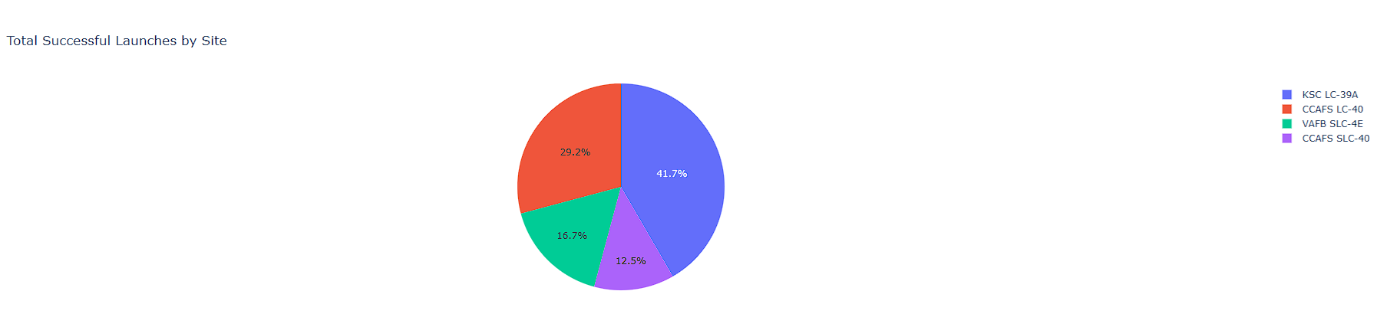
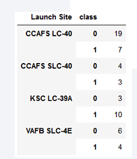
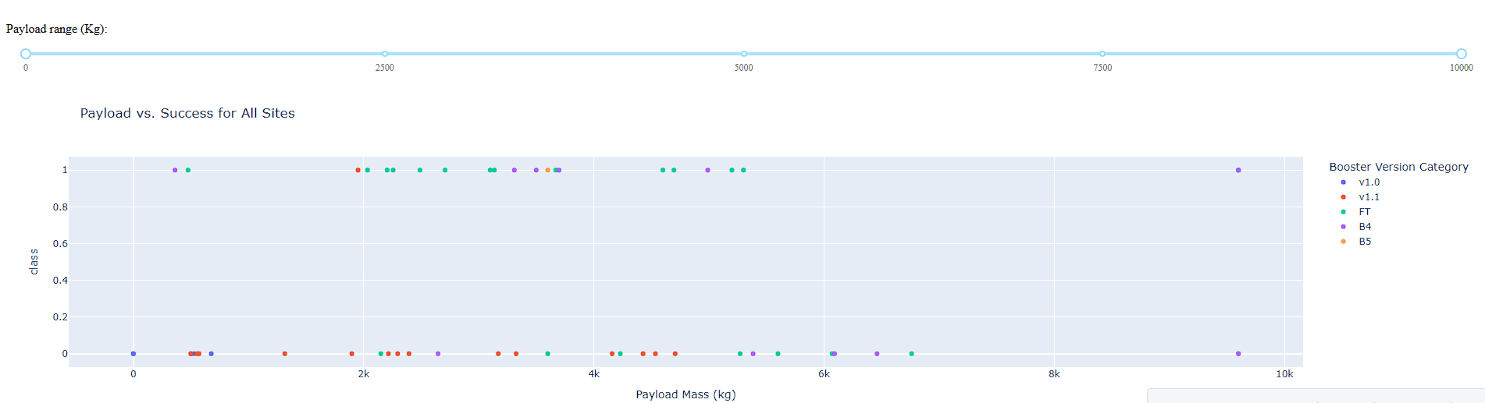
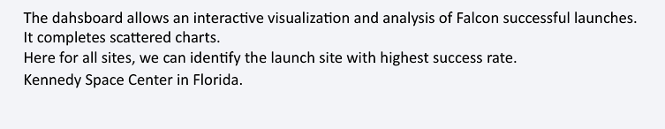
Dashboard
Theis dashboard allaws interactive visualization and análisis of the Falcon 9 successful launches, it is made of an pie chart where we can see the diferente launchsites and the successfull launches of each site

Slide 41
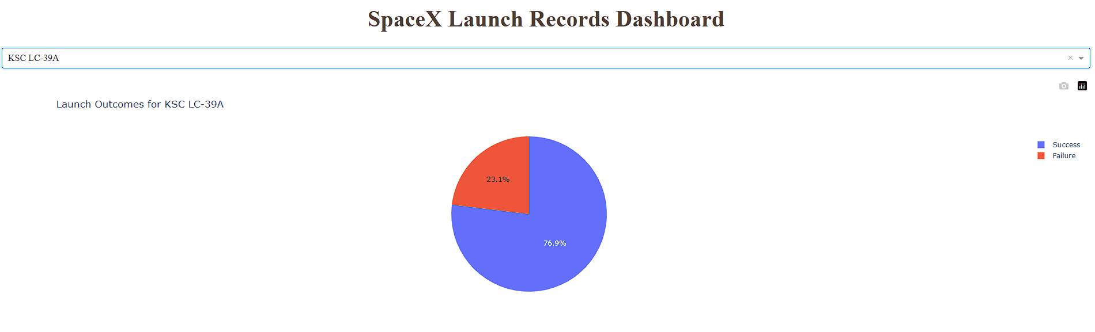
Dashboard Pie Chart
We can see themost succesful launchsite, in this case is KSC LC-39ª , with 13 flights of wich 10 where successfull
We can determinate, that heavy payload are have a higer risk, success does not depend sole it in the booster

Slide 42
Dashboard Scatter Plot
In the scater plot we can conclude that:
v1, and 1.1 are one of the flyes with a very low realibility
Ft (full thrist) is the one with the highest success rate

Slide 43
Section 5
Predictive Analysis
(Classification)

Slide 44
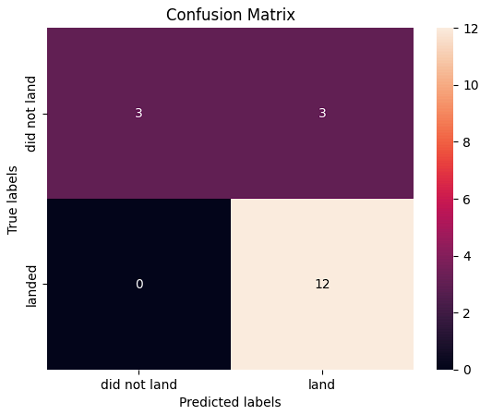
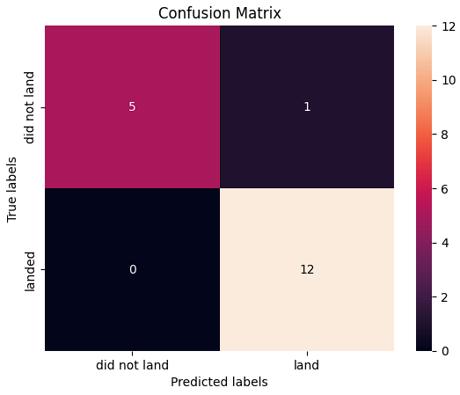
Classification Accuracy
We can se the accuarcy of the 4 models, as we can se the third one has the most accuracy

Slide 45
Confusion Matrix
The confusion matrix of the 3rtd model had the was the best performing model while the other 3 where the same

Slide 46
Conclusions
SpaceX could enhance the success rate of its GEO/GTO launches by adopting an equatorial sea-based launch approach, similar to the past “Sea Launch” platform.
Their Falcon 9 FT boosters have shown reliability by landing on drone ships, which supports the viability of ocean-based operations.
GEO/GTO launches are inherently riskier due to high energy requirements at lift-off and potential vibrational damage to booster electronics and control systems.
SpaceX has publicly stated that each first-stage booster costs more than $15 million, highlighting the financial impact of launch failures
Predictive models were used to estimate SpaceX’s ability to successfully land the first-stage booster.
Three out of four models showed an average accuracy of 83.3%, while the third model reached an impressive 94% accuracy.
Heavier payloads are associated with higher risk of failure, indicating more stress on the system.
Success is not solely dependent on the booster—other factors (like payload mass, launch trajectory, or environmental conditions) also play significant roles.

Slide 47
Appendix
Notebooks to recreate dataset, analysis, and models:
capstone/SpaceX_Machine Learning Prediction_Part_5.ipynb at main · AlbertoArancetMerino/capstone
capstone/dashboard.png at main · AlbertoArancetMerino/capstone
capstone/edadataviz.ipynb at main · AlbertoArancetMerino/capstone
capstone/edadataviz.ipynb at main · AlbertoArancetMerino/capstone
capstone/jupyter-labs-spacex-data-collection-api.ipynb at main · AlbertoArancetMerino/capstone
capstone/jupyter-labs-webscraping.ipynb at main · AlbertoArancetMerino/capstone
capstone/lab_jupyter_launch_site_location.ipynb at main · AlbertoArancetMerino/capstone
capstone/labs-jupyter-spacex-Data wrangling.ipynb at main · AlbertoArancetMerino/capstone
capstone/spacex-dash-app.py at main · AlbertoArancetMerino/capstone
Images sources:
Space Launch Market Size, Growth | Report [2025-2033]
Rocket Propulsion Market Size, Share & Forecast Report - 2032

Slide 48
Thank you!

